Slide 1
UCI GREAT Program Symposium
Facial Emotion Detection
Based on HD Computing
Professor : Mohsen Imani (University of California, Irvine)
Mentor : Yang Ni (University of California, Irvine)
Team Members : Taehyun Kim (Pusan National University)
Janghwan Kim (Pusan National University)
Sehun Jeong (Wonkwang University)
Daeun Park (Dankook University)

Slide 2
Content
01
02
● Background
● Hyperdimensional Computing
● OnlineHD
● Level-ID
03
04
● Facial Emotion
● Results
● Facial Detection
● Future Works
● Histogram of Oriented Gradient

Slide 3
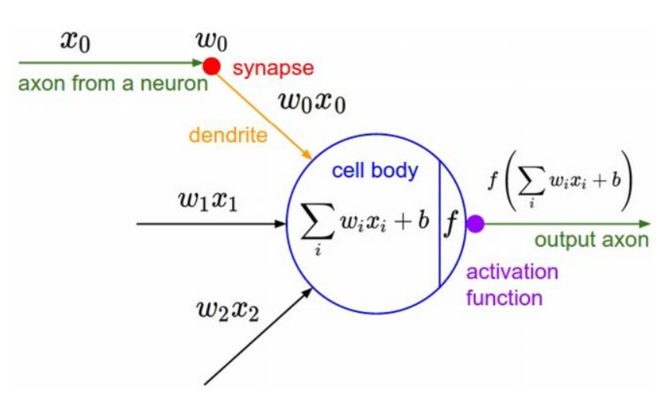
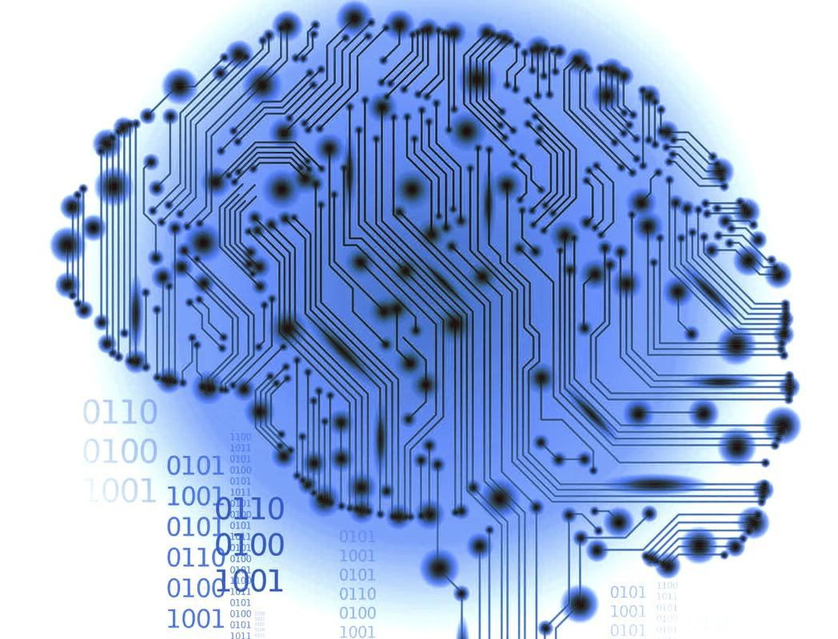
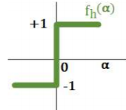
Facial Emotion Detection Based on HD Computing
Section 01
Background
Brain-Inspired Machine Learning
if(input>=0.5) return 1;
else return -1;
(0.50001 ⇒ 1)
(0.49999 ⇒ -1)
http://moimani.weebly.com/research.html
Brain_Inspired Hyperdimensional Computing Preview Image
Notes:
Actually, I wrote a book about a single-layered perceptron using brain structures in artificial intelligence.
I'd like to explain some of those things to you.
Do you like cheese burgers?
...
The beginning of deep learning is made in the 1940's, when McDonald was first created.
Since then, scientists have many questions.
“Is it possible for computers to think and make decisions for themselves, just like humans?”
Then how?
So they mimic the function of the neurons in human brain.
Then, we use Brain-Inspired Machine learning.
Let’s see the image what I put.
This image describes the process of passing information between neurons. You can think of the activation function in the middle as deciding what result to be generated when a certain number of data is received.
Let's take the step function among activation functions as an example.
A step function can be expressed as a conditional function on the image. As you know that code is conditional statement of C language code. It is a step function because the result is returned as 1 or -1. However, There were problems. when comparing 0.5001 and 0.4999, the result is extremely 1 and -1, respectively. Small difference makes big difference. so it is an inefficient method.
So other methods were developed such as sigmoid function, relu function and so on.
Calculating the result by repeating this process is the brain-inspired computing method.
among them is the hyperdimensional computing method.
I'll explain that on the next page.

Slide 4
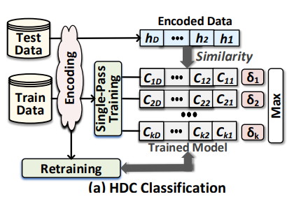
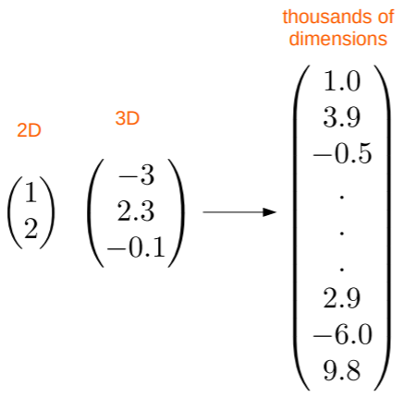
Facial Emotion Detection Based on HD Computing
Section 02
Hyperdimensional Computing (HDC)
A. Hernandez-Cane, N. Matsumoto, E. Ping and M. Imani, "OnlineHD: Robust, Efficient, and Single-Pass Online Learning Using Hyperdimensional System," 2021 Design, Automation & Test in Europe Conference & Exhibition (DATE), 2021, pp. 56-61, doi: 10.23919/DATE51398.2021.9474107.
Notes:
Hyperdimensional computing, or HDC, is a relatively new paradigm for computing using large vectors (like 10000 bits each) and is inspired by patterns of neural activity in the human brain. The means by which can allow AI-based computing systems to retain memory can reduce their computing and power demands.
I’ll keep going in next page.

Slide 5
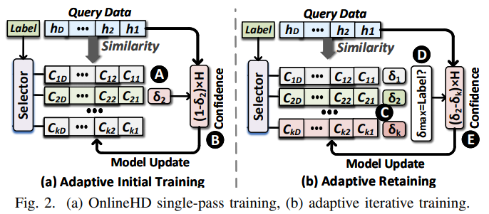
Facial Emotion Detection Based on HD Computing
Section 02
OnlineHD
A. Hernandez-Cane, N. Matsumoto, E. Ping and M. Imani, "OnlineHD: Robust, Efficient, and Single-Pass Online Learning Using Hyperdimensional System," 2021 Design, Automation & Test in Europe Conference & Exhibition (DATE), 2021, pp. 56-61, doi: 10.23919/DATE51398.2021.9474107.
Notes:
The onlinehd technology is a combination of single pass training technology and retraining technology.
To find universal properties of the training data set, the trainer module linearly combines the hypervectors belonging to each class. In other words, it adds hypervectors to create a single hypervector for each class. Combining all the hypervectors, we treat the class-specific cumulative hypervector, called the class hypervector, as a trained model. The figure shows HDC function during single-pass training.
HDC classification using single-pass training has poor classification accuracy. Several recent studies have shown the need to use repetitive training, called retraining, to improve HDC classification accuracy. Retraining can increase the accuracy of the HDC model by discarding mispredicted queries from their corresponding mispredicted classes and adding them to the correct classes. Continue retraining with multiple iterations until the classification accuracy on the validation data changes slightly during the last few iterations.
HDC retraining requires a large number of iterations to converge. Each iteration is computationally expensive as it requires both an associative search and a model update. Our goal is to design a new HDC training algorithm that can simultaneously provide the classification accuracy of iterations and the training efficiency of single-pass training.
One of our team members, Taehyun, will explain Level-ID in the next page.

Slide 6
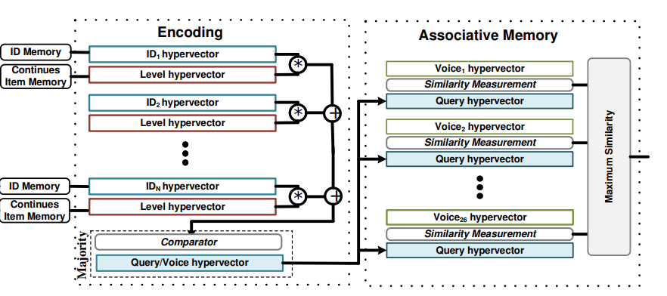
Facial Emotion Detection Based on HD Computing
Section 02
Level-ID
M. Imani, D. Kong, A. Rahimi and T. Rosing, "VoiceHD: Hyperdimensional Computing for Efficient Speech Recognition," 2017 IEEE International Conference on Rebooting Computing (ICRC), 2017, pp. 1-8, doi: 10.1109/ICRC.2017.8123650.
Notes:
Level-ID encodes 2-dimensional arrays into HD space that called encoding and then classifies them by the similarity check that happens in an associative memory.
A 2-dimensional array input sample is seperated into Level and ID hypervector. This encoder assigns a unique channel ID to each intervals of X-axis by generating a random hypervector called ID hypervector. Each input channel ID hypervectors map to the continuous range of Y- axis values. And then continuous item memory divides the full range of Y-axis values to number of levels. For example, let’s devide from -1 to +1 by 10 levels. level 1 is -1, level 2 is -0.8 and level 3 is -0.6.
Then assigns a mixture of correlated and uncorrerlated hypervectors to number of levels. That is called Level Hypervector. Just before, I said correlated and uncorrelated hypervectors. That means we first randomly generate Level 1 hypervector with N dimension for the first level. Then we flip specific bits of Level 1 to generate another hypervector for the next level. So correlated hypervector means that a level is close to another level. On the other hand, we can flip and flip bits from level1 to level10 hypervector. Then Level10 is far away from level1. So we call this uncorrelated. The encoder mutliplies its channel ID hypervector to its corresponding level hypervector. And then we generate a class hypervector by adding all hypervectors which belong to the same class.
Associative memory acts as a kinda storage for the class hypervectors that we have only trained once. Finally, the test data is compared to all stored hypervectors in the associative memory and a class with highest similarity will be returned.
The advantages of level id encoding in this process are fast computation and high accuracy for linear datasets. However, it indicated a much lower accuracy than other HD encoding methods for more complicated datasets.
That’s all about HD computing we’re going to use, and I’ll explain our purpose from the next slide.

Slide 7





















Facial Emotion Detection Based on HD Computing
Section 03
Facial Emotion
Angry
Neutral
Disgusted
Sad
Surprised
Fearful
Happy
48x48 pixel gray scale 35,685 examples
Notes:
The purpose of our project is classifing the facial emotion with onlineHD or Level-ID encoding. The dataset contain 35,685 examples of 48x48 pixel gray scale images of faces divided into train and test dataset. Images are categorized based on the emotion shown in the facial expressions (angry, disgusted, surprised, fearful, neutral, sad and happy)

Slide 8
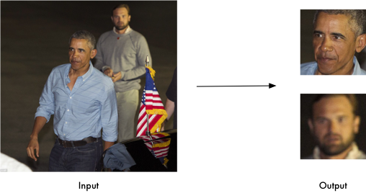
Facial Emotion Detection Based on HD Computing
Section 03
Face Detection
Before
35,685 examples
After
24,941 examples
https://github.com/ageitgey/face_recognition README.md
Notes:
First of all, To classify the facial emotion, we have to kick off to detect the presence of a human face in an input picture. So we used face recognition library to detect a human face. As I said just the before slide, the total number of images we received was about 35,700, and after the face detection, as you can see on the right side, the number of dataset is noticeably decreased. It means that about 10,000 removed data may not be the images of human, or may have difficulty to distinguish facial expressions. It’s good to classify facial expressions right here, but if we directly use the face images that we detected and extracted, it’s expensive and time-consuming for our computer to process. So we used one more method. In the next slides, Sehun will elaborate on that method.

Slide 9
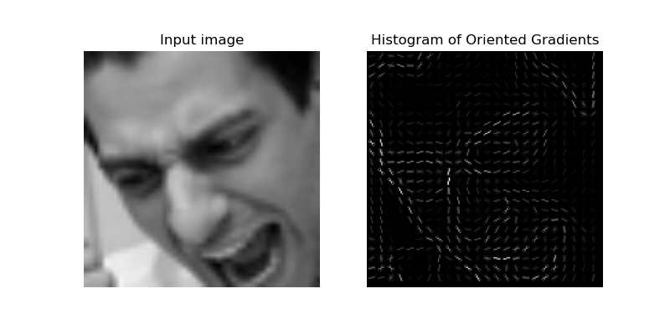
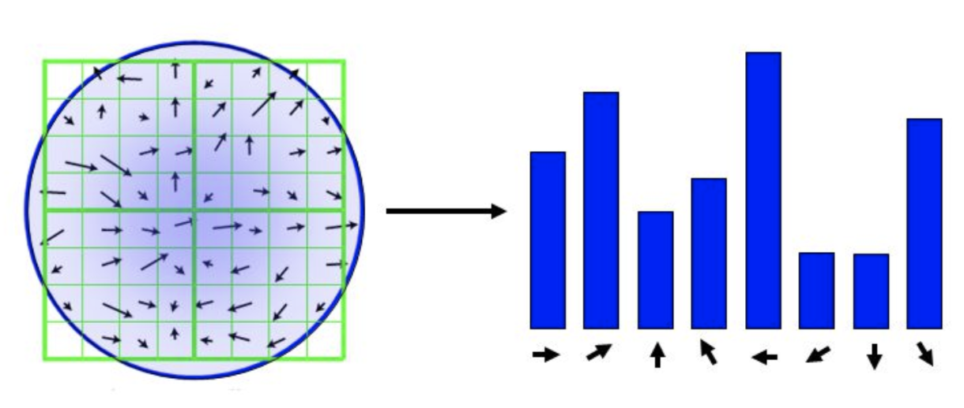
Facial Emotion Detection Based on HD Computing
Section 03
Histogram of Oriented Gradients
https://donghwa-kim.github.io/hog.html
Notes:
We preprocessed facial image data with algorithms called histograms of oriented gradients. The image contains a lot of information. It is reasonable to extract and use only useful information from this image. HOG algorithms are suitable for this feature extraction. This method uses the image's local gradient as a feature of that image. So it is generally used for pedestrian detection and detection of human form.

Slide 10
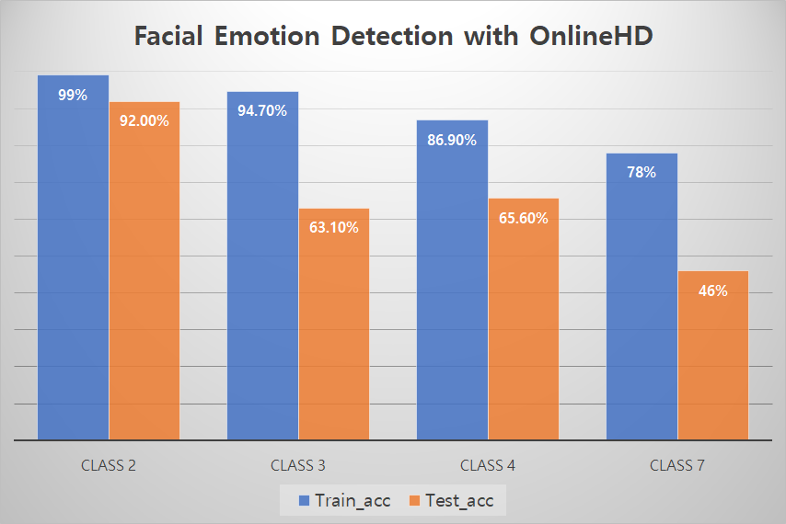
Facial Emotion Detection Based on HD Computing
Section 04
Results
Notes:
This graph is the result of the Faicial emotion detection model with onlineHD. Depending on the type of emotions, it shows the results of two, three, four, and seven classes. As the number of emotions to be classified increased, accuracy decreased. This is a result of overfitting and still needs to be addressed.

Slide 11
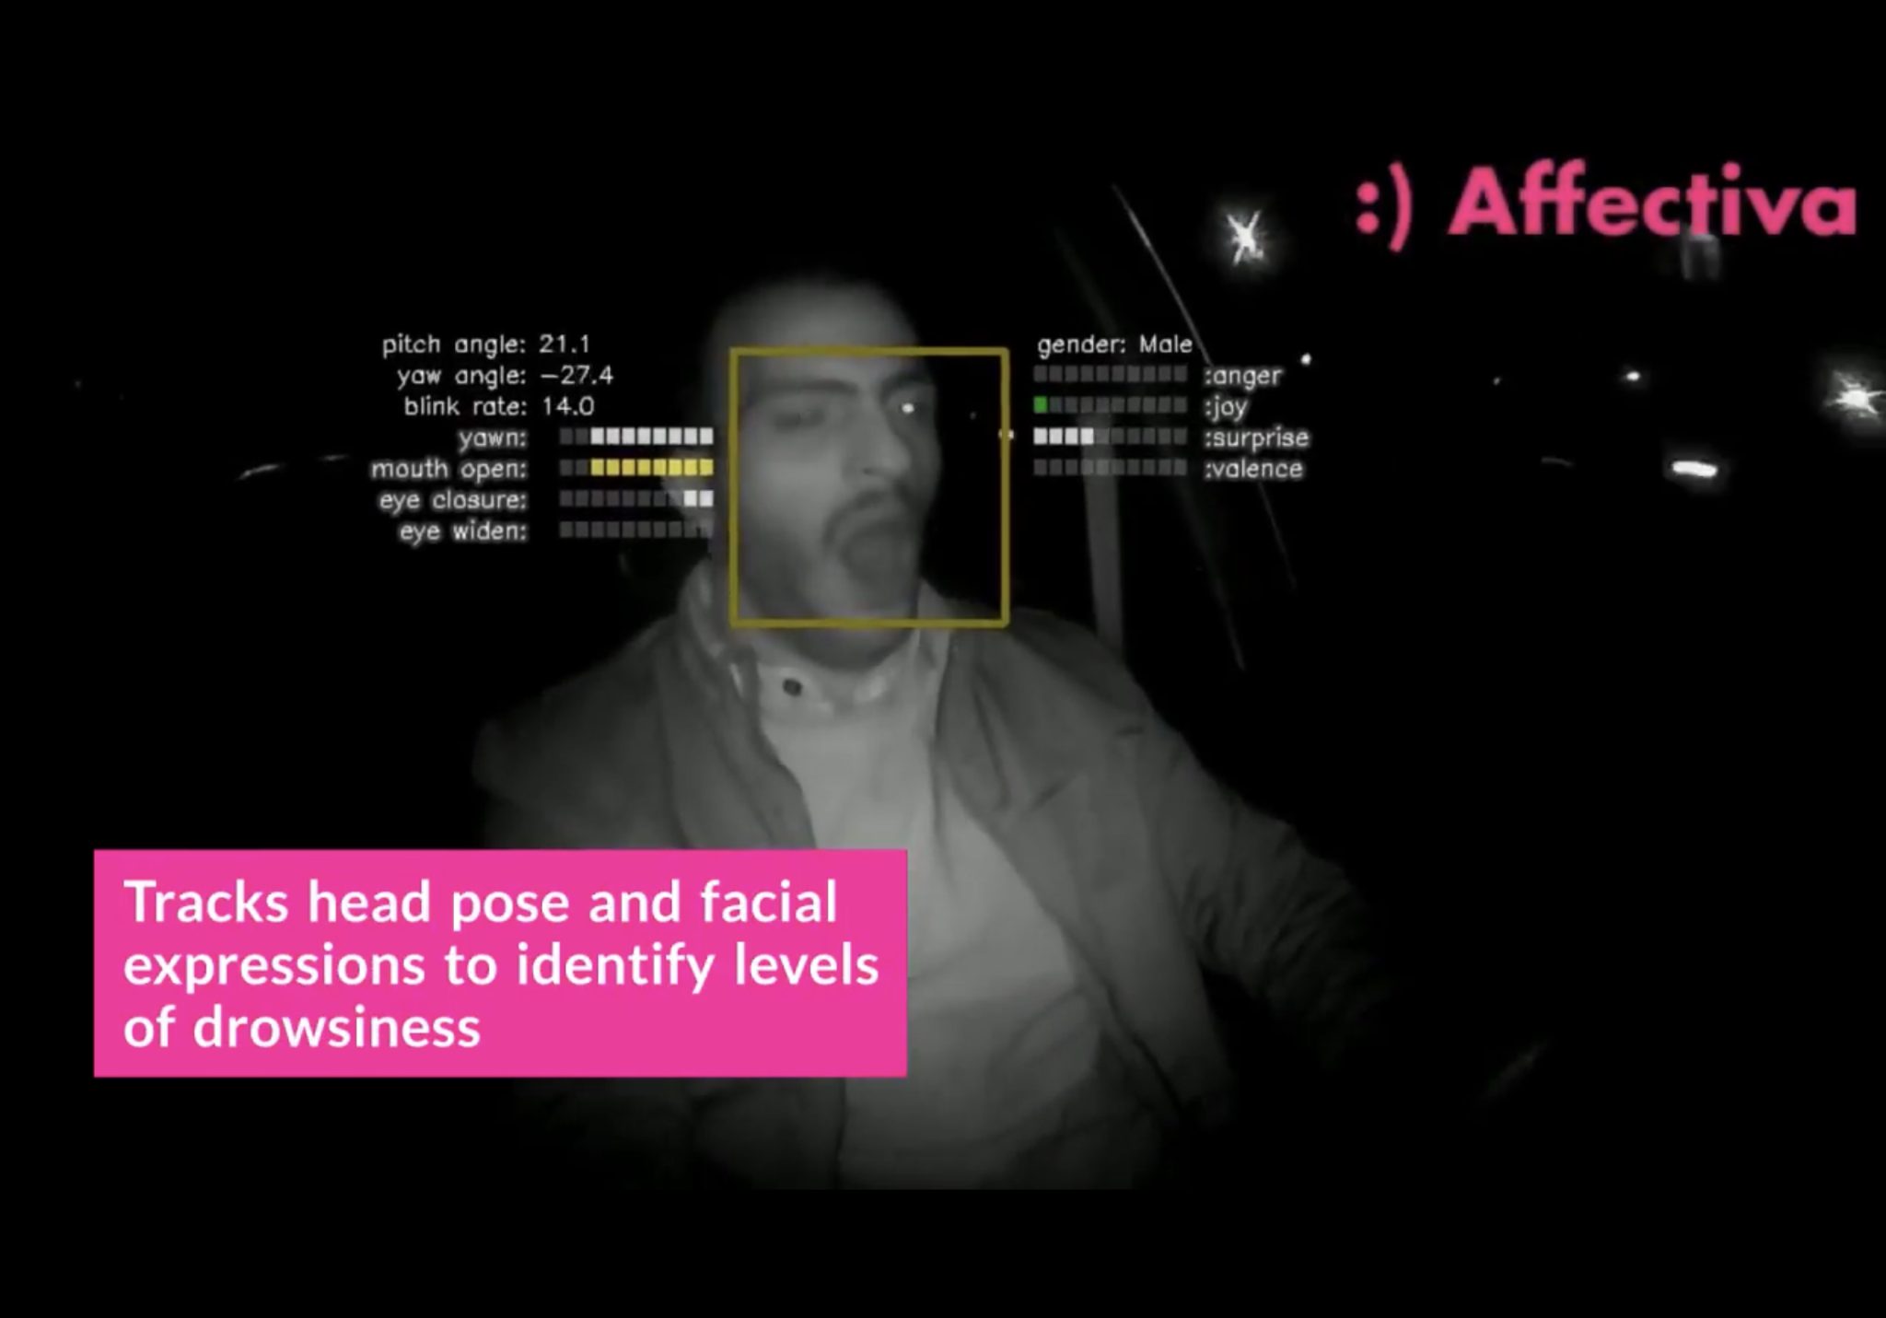
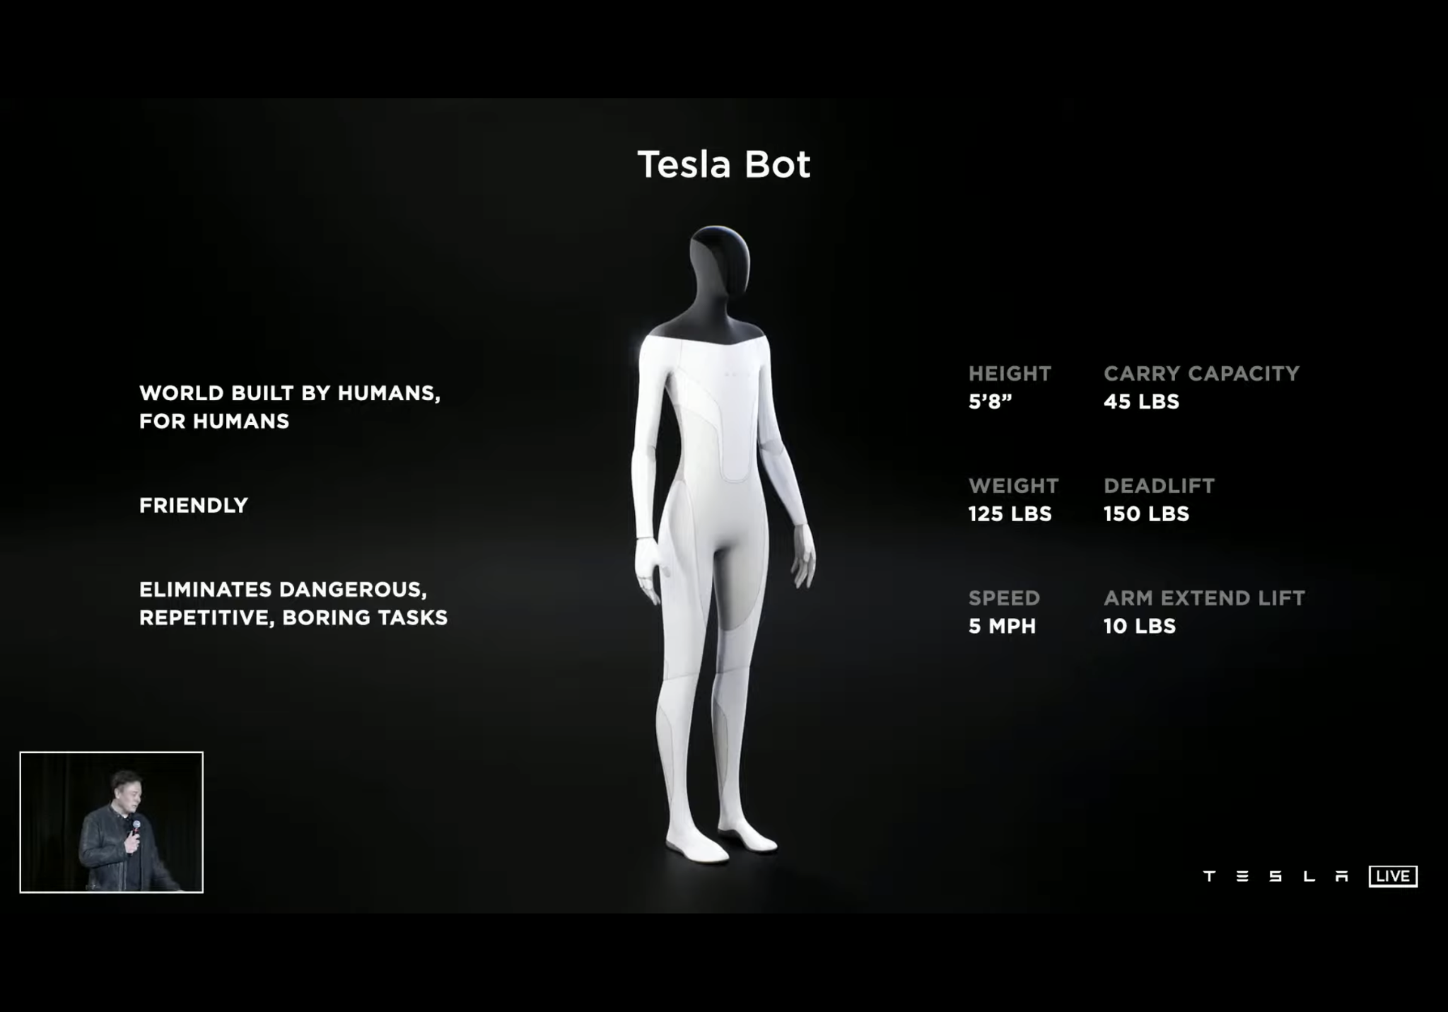
Facial Emotion Detection Based on HD Computing
Section 04
Future works
https://www.youtube.com/watch?v=V_rr7pDPdNM&ab_channel=Affectiva
https://youtu.be/j0z4FweCy4M?t=7712
Notes:
Facial Emotion Detection using Hyperdimensional Computing will be available in a wide range of fields. For example, a camera installed inside a vehicle can be used to recognize the driver's face and identify the emotional state of the expression to help drive safely according to emotions and prevent drowsy driving. It will also help develop humanoid robots that can recognize human emotions and help.

Slide 12




References
A. Hernandez-Cane, N. Matsumoto, E. Ping and M. Imani, "OnlineHD: Robust, Efficient, and Single-Pass Online Learning Using Hyperdimensional System," 2021 Design, Automation & Test in Europe Conference & Exhibition (DATE), 2021, pp. 56-61, doi: 10.23919/DATE51398.2021.9474107.
M. Imani, D. Kong, A. Rahimi and T. Rosing, "VoiceHD: Hyperdimensional Computing for Efficient Speech Recognition," 2017 IEEE International Conference on Rebooting Computing (ICRC), 2017, pp. 1-8, doi: 10.1109/ICRC.2017.8123650.

Slide 13
Thank You!
Q&A
Notes:
Thank you for listening to our presentation.

